Slide 1

“Micro-Credit Defaulter Model”
PPT presented by:-
Diptiranjan Pradhan
Intern of FlipRobo Technologies
Under Guidance of:-
Khushboo Garg

Slide 2
Overview:-
In this particular presentation we will be looking on:
How to analyze the dataset of Micro Credit Defaulters.
What are the EDA steps in cleaning the dataset.
Overall analysis on the problem.
Model building from the cleaned dataset.
Predicting defaulters for saved model.

Slide 3
Problem Statement:-
A Microfinance Institution (MFI) is an organization that offers financial services to low income populations. MFS becomes very useful when targeting especially the unbanked poor families living in remote areas with not much sources of income. The Microfinance services (MFS) provided by MFI are Group Loans, Agricultural Loans, Individual Business Loans and so on.
Many microfinance institutions (MFI), experts and donors are supporting the idea of using mobile financial services (MFS) which they feel are more convenient and efficient, and cost saving, than the traditional high-touch model used since long for the purpose of delivering microfinance services. Though, the MFI industry is primarily focusing on low income families and are very useful in such areas, the implementation of MFS has been uneven with both significant challenges and successes.
Today, microfinance is widely accepted as a poverty-reduction tool, representing $70 billion in outstanding loans and a global outreach of 200 million clients.
We are working with one such client that is in Telecom Industry. They are a fixed wireless telecommunications network provider. They have launched various products and have developed its business and organization based on the budget operator model, offering better products at Lower Prices to all value conscious customers through a strategy of disruptive innovation that focuses on the subscriber.

Slide 4
They understand the importance of communication and how it affects a person’s life, thus, focusing on providing their services and products to low income families and poor customers that can help them in the need of hour.
They are collaborating with an MFI to provide micro-credit on mobile balances to be paid back in 5 days. The Consumer is believed to be defaulter if he deviates from the path of paying back the loaned amount within the time duration of 5 days. For the loan amount of 5 (in Indonesian Rupiah), payback amount should be 6 (in Indonesian Rupiah), while, for the loan amount of 10 (in Indonesian Rupiah), the payback amount should be 12 (in Indonesian Rupiah).
The sample data is provided to us from our client database. It is hereby given to you for this exercise. In order to improve the selection of customers for the credit, the client wants some predictions that could help them in further investment and improvement in selection of customers.

Slide 5
Problem Understanding:-
Telecom Industries understand the importance of communication and how it affects a person’s life, thus, focusing on providing their services and products to low income families and poor customers that can help them in the need of hour. They are collaborating with an MFI to provide micro-credit on mobile balances to be paid back in 5 days. The Consumer is believed to be defaulter if he deviates from the path of paying back the loaned amount within the time duration of 5 days. For the loan amount of 5 (in Indonesian Rupiah), payback amount should be 6 (in Indonesian Rupiah), while, for the loan amount of 10 (in Indonesian Rupiah), the payback amount should be 12 (in Indonesian Rupiah). The sample data is provided to us from our client database. It is hereby given to you for this exercise. In order to improve the selection of customers for the credit, the client wants some predictions that could help them in further investment and improvement in selection of customers. We have to build a model which can be used to predict in terms of a probability for each loan transaction, whether the customer will be paying back the loaned amount within 5 days of insurance of loan. In this case, Label ‘1’ indicates that the loan has been payed i.e. Non- defaulter, while, Label ‘0’ indicates that the loan has not been payed i.e. defaulter.

Slide 6
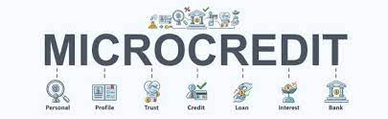
What is Micro Credit?
Microcredit is an extremely small loan given to those who lack a steady source of income, collateral. It is used as a way to obtain a loan, acting as a protection against potential loss for the lender should the borrower default in his payments., or any credit history.

Slide 7

Importance of Micro Credit Defaulters Model:-
Poverty alleviation programs provide material, funds, information and project services for people with no income or work opportunities. Because of the credit risks and relatively high costs associated with small loans, the traditional banking system is generally not willing to implement a microcredit system. The borrowers have no collateral to put up against loans and often are refused the needed capital because of the high risk of default. If they resort to underground sources, they are often charged exorbitant interest. This quick fix solution does not address the main structural problem: a lack of proper funding channels

Slide 8
Exploratory Data Analysis:-
As a first step I have imported required libraries and I have imported the dataset which was in csv format.
Then I did all the statistical analysis like checking shape, nunique, value counts, info etc…..
While checking the value counts of the datasets I found some columns with more than 90% zero values, so these columns will create skewness in datasets so I decided to drop those columns.
While Checking the null values I found there is no null values in the dataset.
Then I have extracted day, month, year from pdate.
In the dataset there was some negative values so I converted those negative values to positive values using abs.

Slide 9
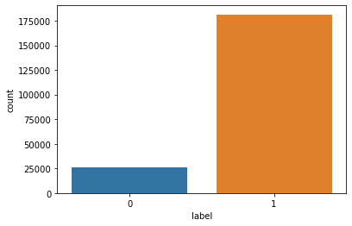
Vizualization[Univariate-Target]:-
There is a data imbalancing issue so we have to treat this by using oversampling or undersampling.

Slide 10
Model Building:-
Since Label was my target and it was a Categorical column, so this perticular problem was Classification problem. And I have used all Classification algorithms to build my model. By looking into the difference of accuracy score and cross validation score I found BaggingClassifier as a best model with least difference. Also to get the best model we have to run through multiple models and to avoid the confusion of overfitting we have go through cross validation. Below are the list of Classification algorithms I have used in my project.
DT=DecisionTreeClassifier
XGBC=GradientBoostingClassifier
RFC=RandomForestClassifier

Slide 11
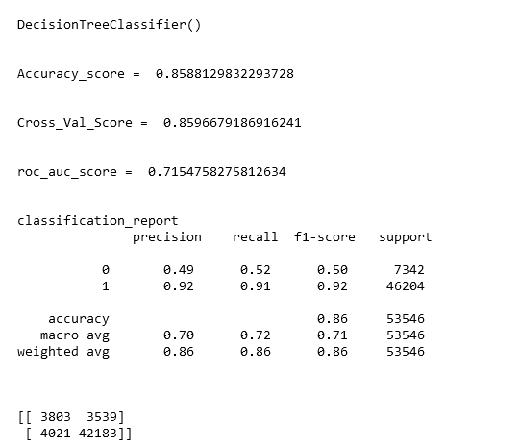

Slide 12
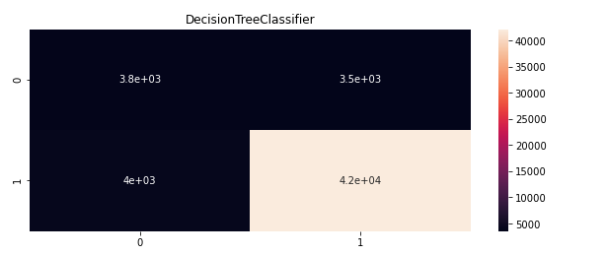
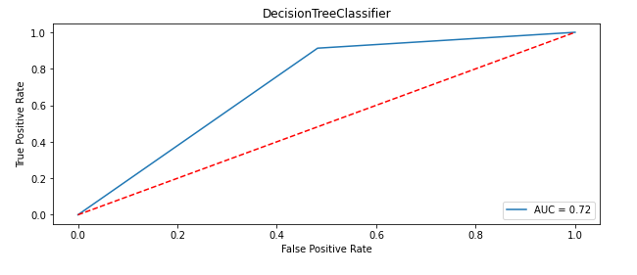

Slide 13
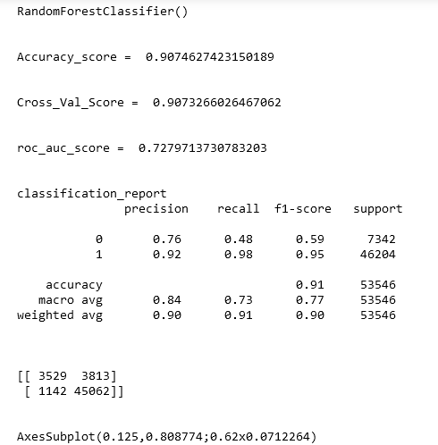

Slide 14

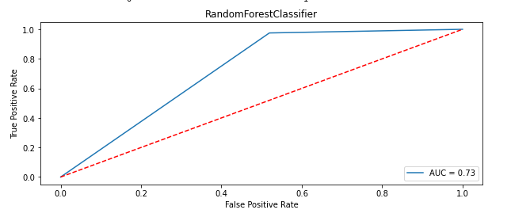

Slide 15
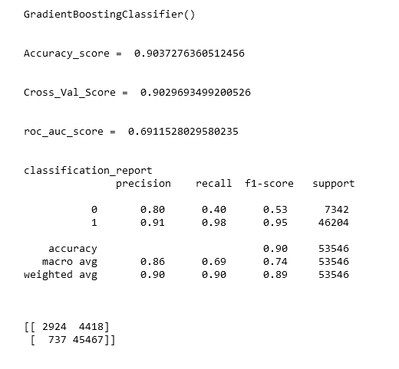

Slide 16
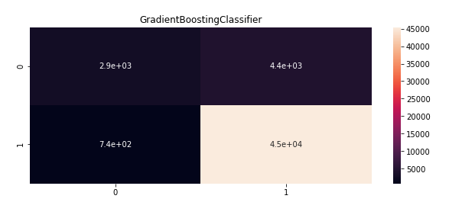
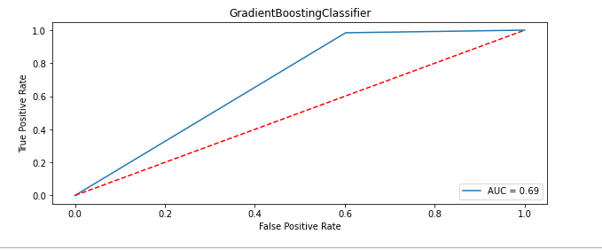

Slide 17
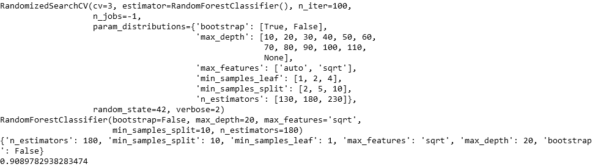
Best parameters:-

Slide 18
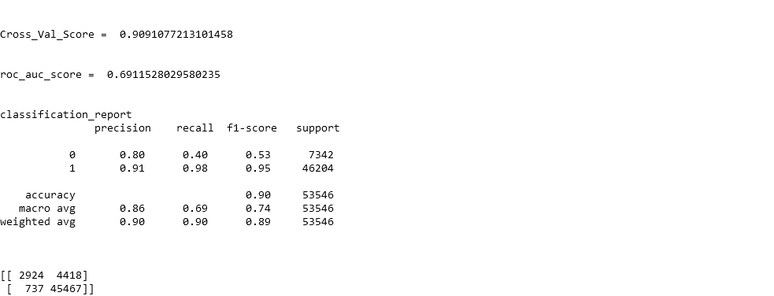
Cross validation:-

Slide 19
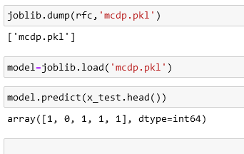
Saving the model and predictions using saved model:-

Slide 20


